Slide 1

Slide 1
TELECOMMUNICATION
CUSTOMER CHURN ANALYSIS
11th September 2021
Victoria Loo

Slide 2



CUSTOMER CHURN
Customer churn is a common business problem across many industries.
Every time a customer leaves or cancels a subscription, it causes a significant loss on the business revenue. It also hinders company’s potential for growth.
Cost of acquiring a new customer is FIVE times more than cost of retaining an existing customer
15 telco companies (at least) in Australia
also known as customer turnover or loss of customers

Slide 3
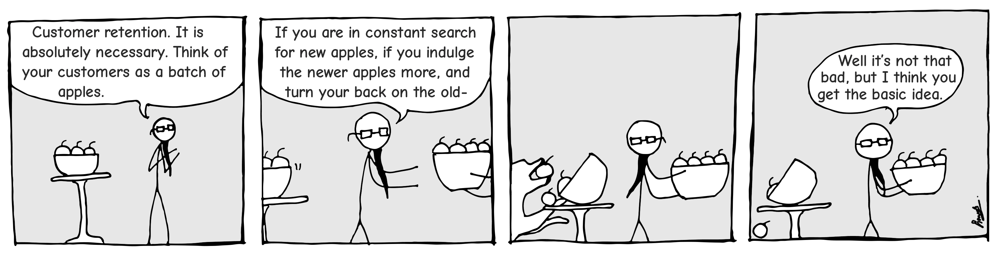
BUSINESS QUESTION?
HOW CAN WE PREDICT CUSTOMER CHURN TO IMPROVE CUSTOMER RETENTION?

Slide 4
DATA QUESTION?
WHAT MODEL CAN WE CREATE & USE TO EFFECTIVELY PREDICT CUSTOMER CHURN?

Slide 5





PROJECT PIPELINE
Data Acquisition
Data Pre Processing
Model Building
Exploratory Data
Analysis
Model Selection
& Evaluation
Data Transformation

Slide 6



DATA OVERVIEW
20 Features
7,043 Observation
IBM – Cognos Analytics
Demographic | Customer ID
Phone Service | Gender
Multiple Lines | Senior Citizen
Internet Service | Partner
Online Security | Dependent
Account Information | Tenure
Phone Service | Contract
Multiple Lines | Paperless Billing
Internet Service | Payment Method
Online Security | Monthly Charges
 | Total Charges
Managed Services | Phone Service
Phone Service | Multiple Lines
Multiple Lines | Internet Service
Internet Service | Online Security
 | Online Backup
 | Device Protection
 | Tech Support
Online Security | Streaming TV
 | Streaming Movies

Slide 7
EXPLORATORY DATA ANALYSIS
CHURN RATE
26% customers have cancelled their telecom services.
26%
YELLOW Represents Customer Churn Rates
DEMOGRAPHICS
Gender
Partner
Dependents
Senior Citizen

Slide 8
EXPLORATORY DATA ANALYSIS
ACCOUNT INFORMATION vs CHURN RATE
Contract
Payment Method
‘Month-to-month contract’ has higher churn rate
‘Electronic cheque’ has higher
churn rate
YELLOW Represents Customer Churn Rates

Slide 9
EXPLORATORY DATA ANALYSIS
ACCOUNT INFORMATION vs CHURN RATE
Tenure
(Number of months customer has been with the company)
Monthly Charges
Tenure Increment = Churn Rate Reduction
Higher Monthly Charges = Higher Churn Rate
YELLOW Represents Customer Churn Rates

Slide 10
EXPLORATORY DATA ANALYSIS
MANAGED SERVICES vs CHURN RATE
Device Protection
Online Backup
Internet Service
Customers with additional services have lower churn rate
Tech Support
Online Security
Phone Service
Customers with no internet service have lower churn rate
YELLOW Represents Customer Churn Rates

Slide 11
DATA PRE-PROCESSING & TRANFORMATION
DATA PRE-PROCESSING
DATA TRANSFORMATION
Removal of missing values
Removal of insignificant features
Removal of highly correlated features
Fixing imbalance data (26% churn rate) through:
Under-sampling (Re-sampling method)
SMOTE
ADASYN
Scaling of data for 3 features:
Monthly Charges
Tenure
Total Charges
Encoding categorical values
Transforming to binary integers

Slide 12
DATA TRANSFORMATION
FEATURE SELECTION (7 features selected based on feature importance score)

Slide 13
MODEL SELECTION & EVALUATION
20XX
CHOICE OF MODELS
CHOICE OF CLASSIFICATION
METRICS
Logistic Regression
Support Vector Machines (SVM)
Naïve Bayes
K-Nearest Neighbor (KNN)
Random Forest Classifier
Recall (True Positive Rate)
F1
ROC-AUC

Slide 14

RESULTS
MODELS EVALUATION – BASELINE (IMBALANCED DATA)
Logistic
Regression
Model | Feature Engineering | Accuracy Scores (Training) | Accuracy Scores (Test) | Recall | Precision
Logistic Regression | None | 0.81 | 0.81 | 0.57 | 0.66
Support Vector Machines | None | 0.82 | 0.80 | 0.51 | 0.65
Naive Bayes | None | 0.70 | 0.68 | 0.84 | 0.45
KNN | None | 0.61 | 0.60 | 0.60 | 0.60
Random Forest Classifier | None | 0.86 | 0.79 | 0.52 | 0.63
Most models have HIGH accuracy scores due to imbalance data.
Most models have LOW recall scores, which is not ideal
The best baseline model is Naïve Bayes

Slide 15
RESULTS
MODELS EVALUATION
(UNDERSAMPLING / SMOTE / ADASYN)
Model | Feature Engineering | Recall | F1 | ROC - AUC
Logistic Regression | Under Sampling | 0.79 | 0.61 | 0.84
SVM | Under Sampling | 0.88 | 0.55 | 0.81
Naïve Bayes | Under Sampling | 0.84 | 0.67 | 0.81
KNN | Under Sampling | 0.89 | 0.54 | 0.81
Random Forest Classifier | Under Sampling | 0.78 | 0.61 | 0.83
Logistic Regression | SMOTE | 0.69 | 0.6 | 0.82
SVM | SMOTE | 0.7 | 0.6 | 0.82
Naïve Bayes | SMOTE | 0.79 | 0.6 | 0.8
KNN | SMOTE | 0.77 | 0.6 | 0.82
Random Forest Classifier | SMOTE | 0.79 | 0.61 | 0.83
Logistic Regression | ADASYN | 0.74 | 0.6 | 0.81
SVM | ADASYN | 0.83 | 0.59 | 0.81
Naïve Bayes | ADASYN | 0.8 | 0.59 | 0.8
KNN | ADASYN | 0.77 | 0.6 | 0.82
Random Forest Classifier | ADASYN | 0.84 | 0.59 | 0.82
Resampling imbalanced data via:
Oversampling (SMOTE/ADASYN)
Undersampling
All models have relatively higher recall scores. (better than baseline)
F1 and ROC-AUC scores are similar to baseline

Slide 16
RESULTS
MODELS EVALUATION – FINAL STEP
Model | Feature Engineering | Recall | F1 | ROC - AUC
SVM | 7 Features / ADASYN | 0.9 | 0.57 | 0.82
Naïve Bayes | 7 Features / ADASYN | 0.89 | 0.55 | 0.82
Logistic Regression | 7 Features / ADASYN | 0.87 | 0.57 | 0.82
SVM | 7 Features / SMOTE | 0.88 | 0.58 | 0.83
Naïve Bayes | 7 Features / SMOTE | 0.87 | 0.57 | 0.82
Hyperparameter tuning & feature selection applied to further improve models.
Most models have better recall scores.
The BEST model is
SVM with 7 features and ADASYN

Slide 17

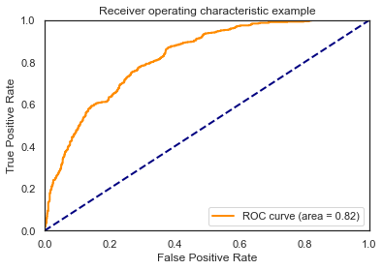
SUMMARY
BEST MODEL
Support Vector Machines Model
(7 Features, ADASYN)
Accuracy Scores (Training) | Accuracy Scores (Test) | Recall | Precision | F1 | ROC - AUC
0.68 | 0.66 | 0.9 | 0.42 | 0.57 | 0.82

Slide 18


SUMMARY
Key Features
Improvement 1
Improvement 2
Customers who are more likely to churn:
Month to month contract
Electronic cheque payment
Short Tenure
High monthly charges
Fibre Optic Internet Service
Collect more data to improve performance metrics.
More hyperparameter tuning (due to limited time unable to tune more than 3 parameters).
Improvement 3
Improvement 4
Select more complex models like deep neural network for better prediction.
Perform ensemble method on poorly performing classifiers to improve accuracy.

Slide 19
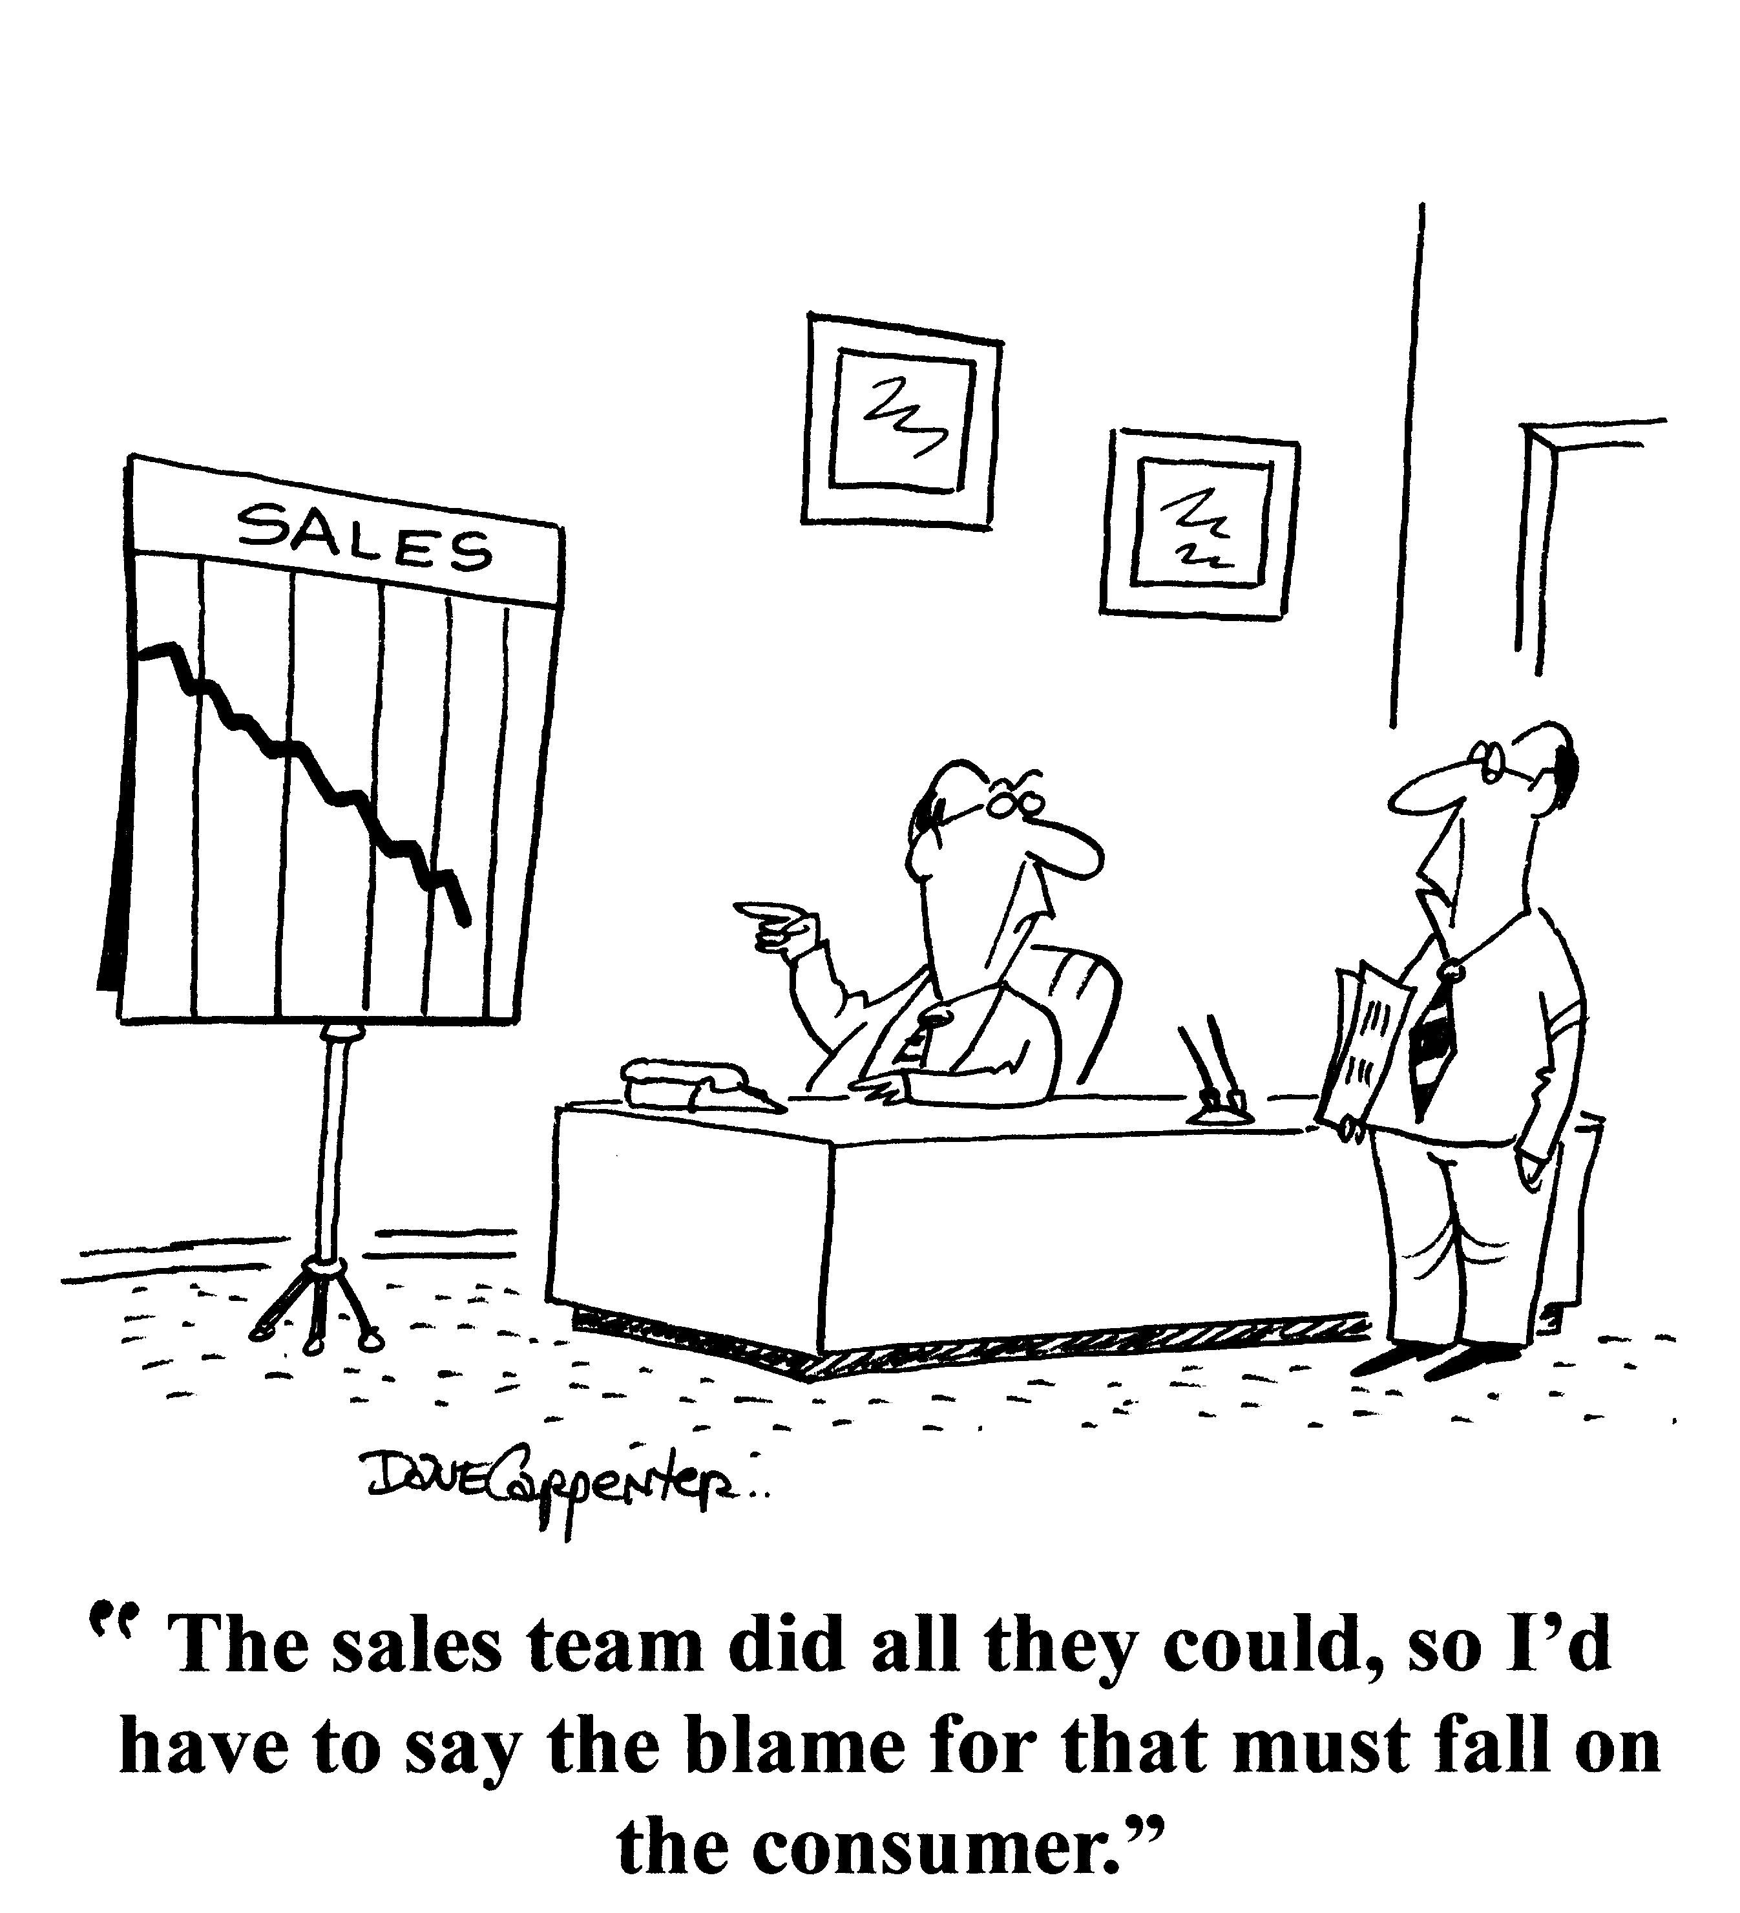
NEXT STEPS?
Key insights of data analysis between churn rate and
customer features can be useful for the sales/marketing team
to plan customer retention strategy.
Deploy model onto Customer Management System.

Slide 20
THANK YOU!

